Slide 1
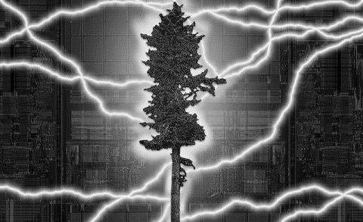

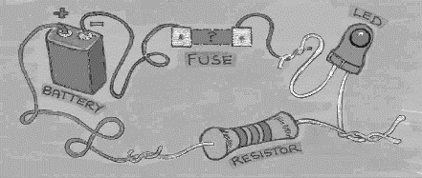
EHB222E QUESTIONS

Slide 2
What is the equivalent resistance (Req) of the circuit below?
Answer: 14.4ohm

Slide 3
What is the equivalent resistance (Req) of the circuit below?
Answer: 11.2ohm

Slide 4
Determine Vo in the circuit below.
Answer: 18V

Slide 5
Calculate the voltage across 20k resistor.
Answer: 2kV

Slide 6
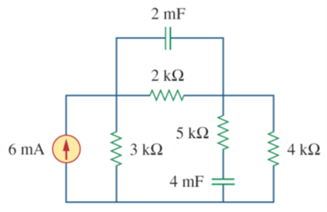
Calculate the charge stored in 4mF capacitor in under DC conditions
Answer: 32uC

Slide 7
A telephone wire has a current of 300mA flowing through it. How long does it take for a charge of 18C to pass through the wire?
Answer: 60sn

Slide 8
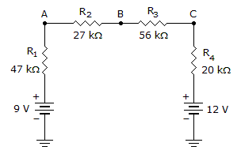
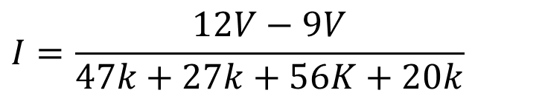


Calculate the voltage at point B in the given circuit.
$$I$$
$$I=\frac{12V−9V}{47k+27k+56K+20k}$$
$$V_{B}=12V−I (20k+56k)$$

Slide 9
If you put an infinite number of resistors in parallel, what would the total resistance be?
Answer:
0 Ohm

Slide 10
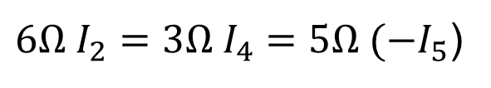
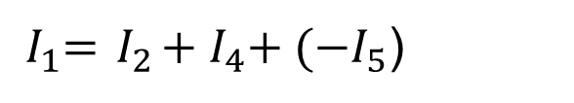
Calculate current values. I₄=4A
Answer:
${6Ω I}_{2}={3Ω I}_{4}={5Ω (−I}_{5}$)
${ I}_{1}={ I}_{2}+{{ I}_{4}+ (−I}_{5}$)

Slide 11
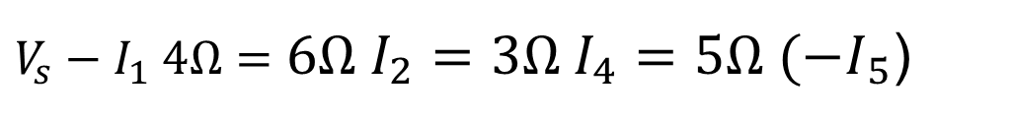
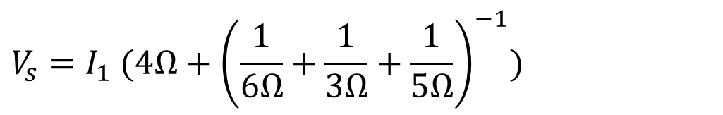
Calculate current values. V_{S}=4V
Answer:
$$V_{s}=I_{1} (4Ω+{\left(\frac{1}{6Ω}+\frac{1}{3Ω}+\frac{1}{5Ω}\right)}^{−1})$$
$V_{s}−I_{1} 4Ω={6Ω I}_{2}={3Ω I}_{4}={5Ω (−I}_{5}$)
Notes:
Direnç isimleri

Slide 12
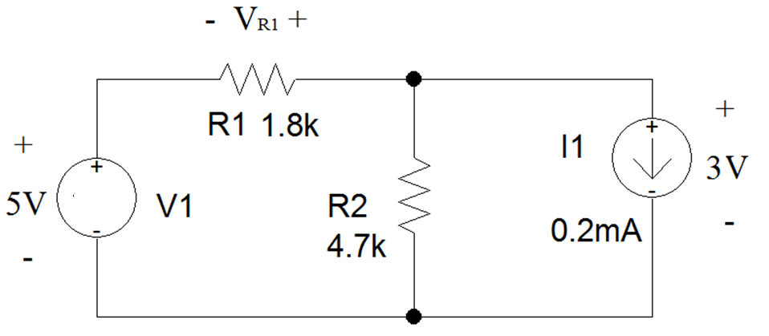
Find the voltage across R1. Note that the polarity of the voltage has been assigned in the circuit schematic.
Notes:
Direnç isimleri

Slide 13
Write equations to compute voltages v₁ and v₂ , next find the current value of i₁
i₁
From KCL:
50 mA=v₁/40+(v₁-v₂)/40
and
100 mA=v₂/80+(v₂-v₁)/40
i₁
v₁
v₂
50 mA
100 mA
Multiply first equation by 40:
2=v₁+v₁-v₂=2v₁-v₂
Multiply second equation by 80:
8=v₂+2(v₂-v₁)=3v₂-2v₁
add both sides:
10=2v₂ => v₂=5V, v₁=1+v₂ /2=3.5V
i₁= (v₁-v₂)/40=-1.5/40=-37.5 mA

